Slide 1
Designing High Performance Helicon Peptide Therapeutics
April 11th, 2025
John Santa Maria, Parabilis Medicines

Slide 2
Disclosure:
The terms “predict” and “identify” in relationship to machine learning model output are used in a statistical sense. These outputs reflect patterns learned from data and do not imply accuracy, determinism, or causality. All model results must be interpreted with domain expertise and independently validated before being acted upon.

Slide 3
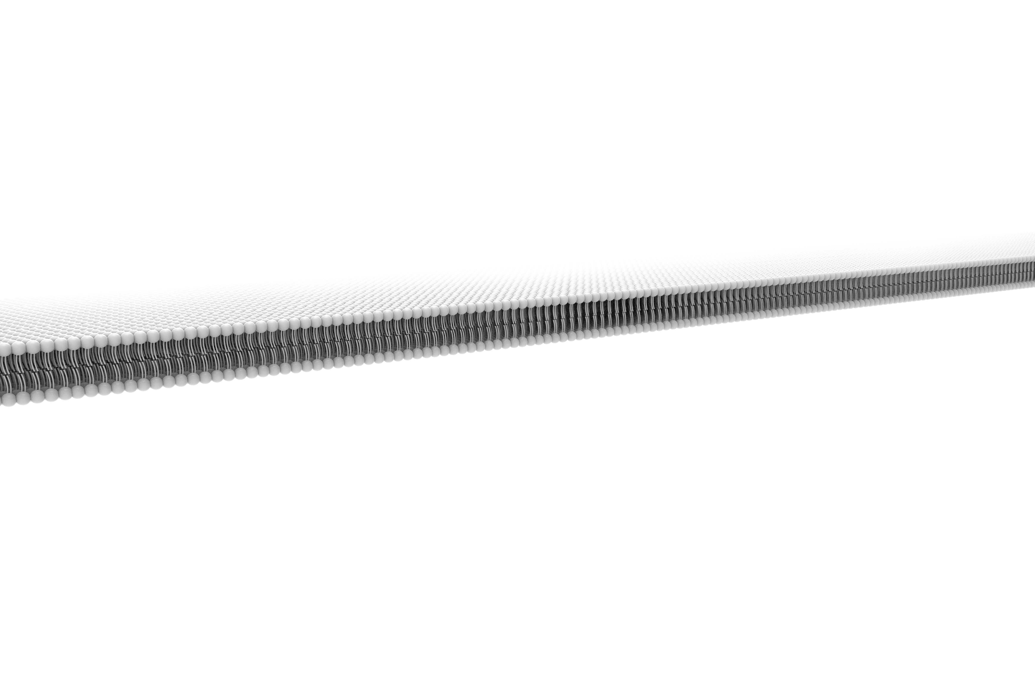
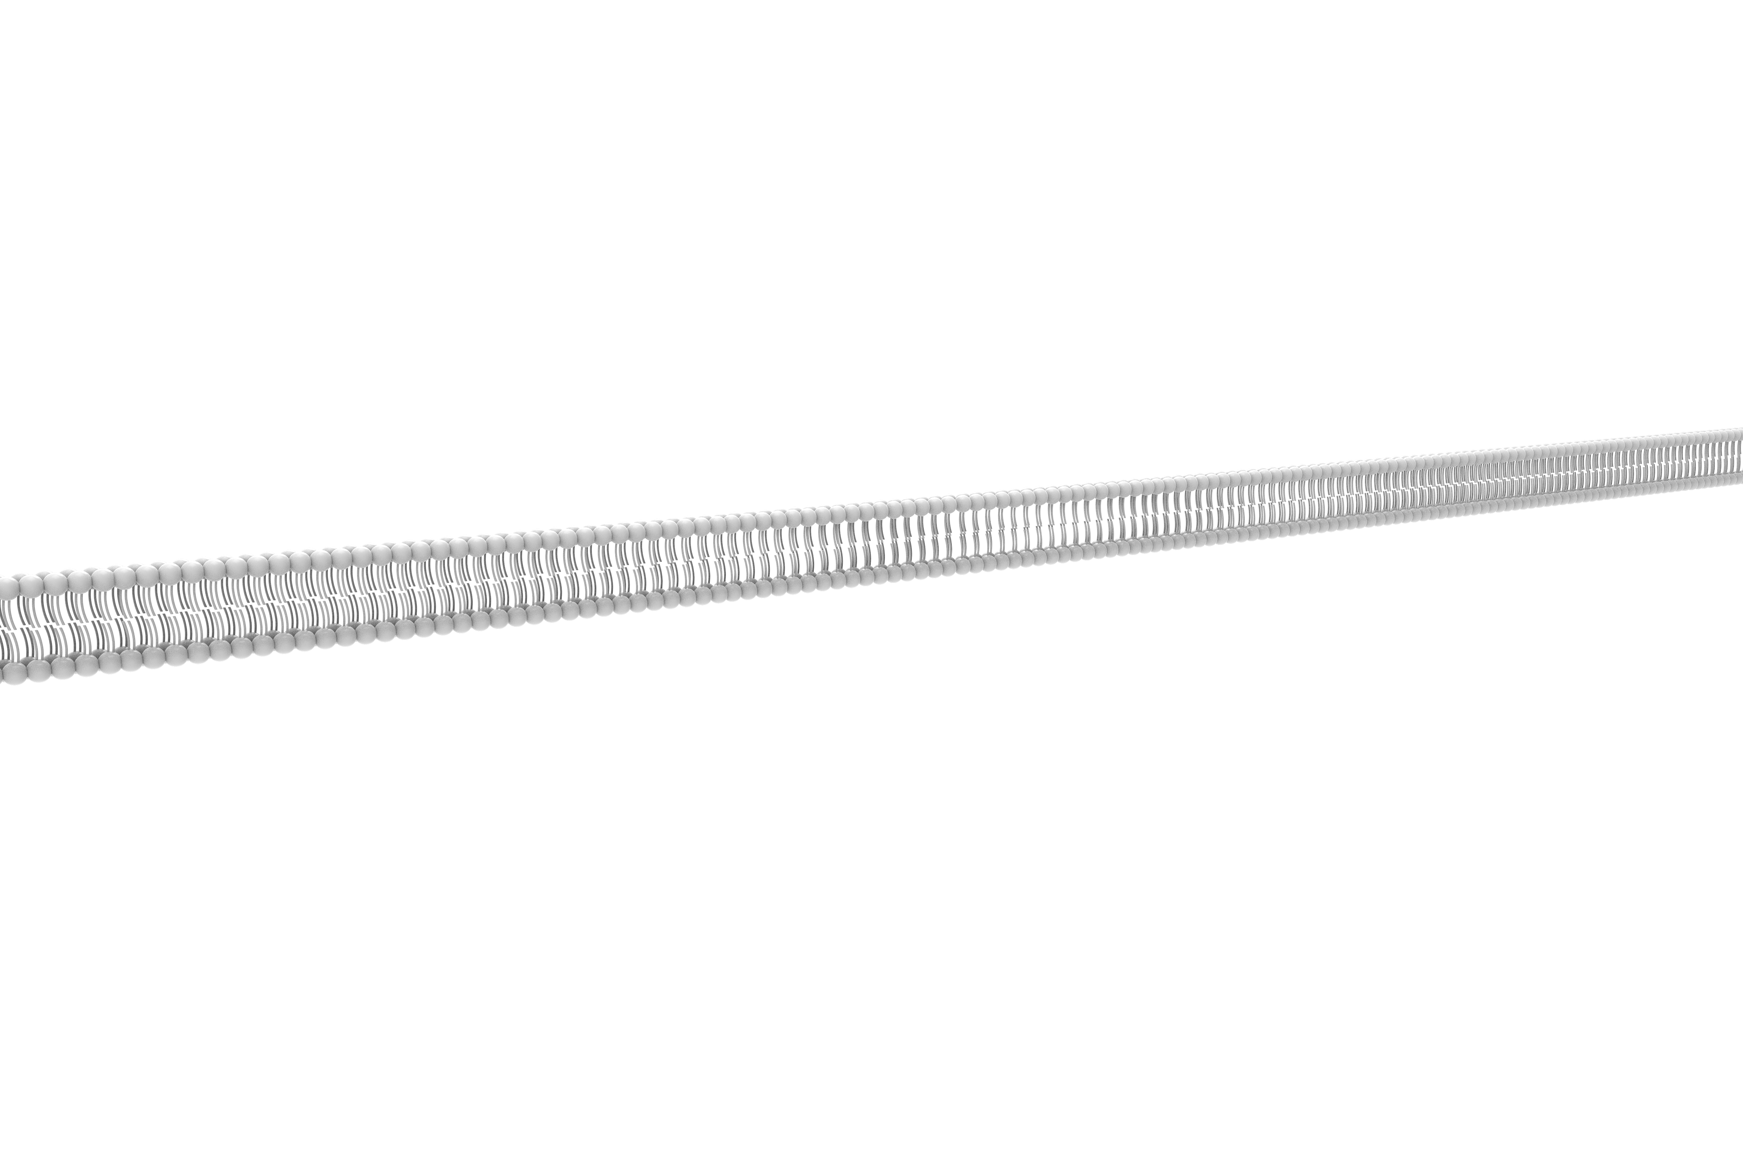
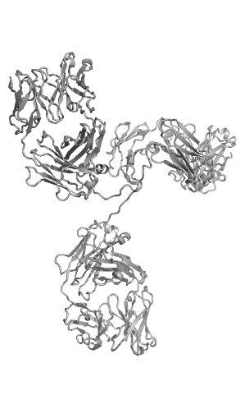
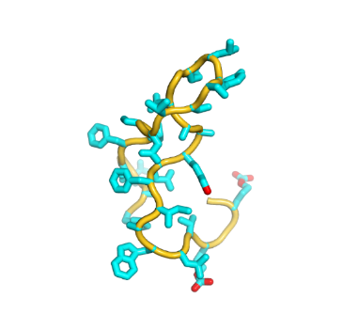
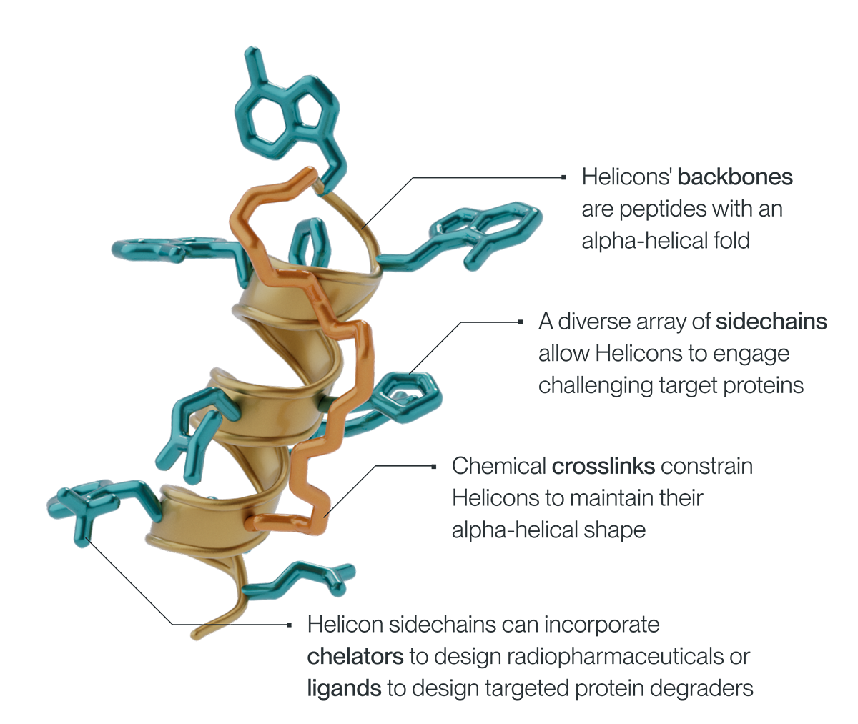
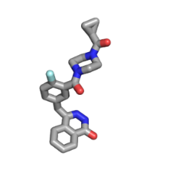
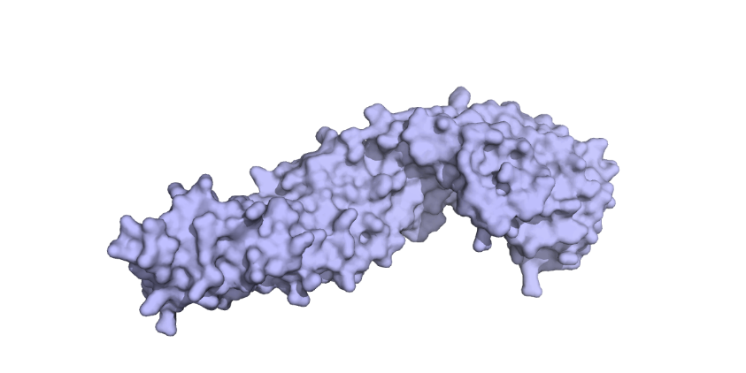
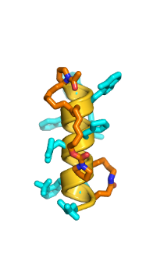
Drugging Previously "Undruggable" Protein Targets With Helicons
Biologic
Small Molecule
Non-Helical Peptide
The solution. Helicons:
The problem:
Today’s dominant drug types, small molecules and antibodies, fundamentally can’t access a substantial percentage of potential drug targets – e.g. protein-protein interactions occurring inside a cell
X
X
cytosol
X
β-catenin
Notes:
Even if we have a strong therapeutic hypothesis, creating an actual drug candidate is another daunting task. If the target protein is an enzyme or receptor (GPCR) on the cell surface, a small molecule might work. If the target is involved in protein-protein interactions outside the cell, we might be able to use a monoclonal antibody. But if it’s inside the cell, those protein-protein interactions become incredibly hard to target. This is where Parabilis plays a critical role. Must clearly describe here the problem statement, its importance, and magnitude across modern drug discovery.
The chemical crosslinks in Helicons also have the advantage of 1) tuning drug-like properties and 2) engaging with the target
Undruggable targets Beyond the reach of small molecules

Slide 4
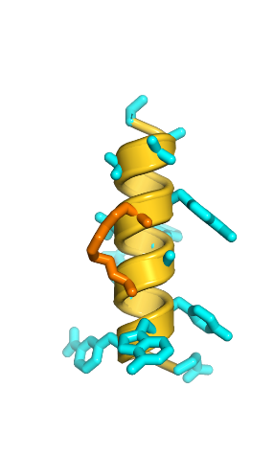
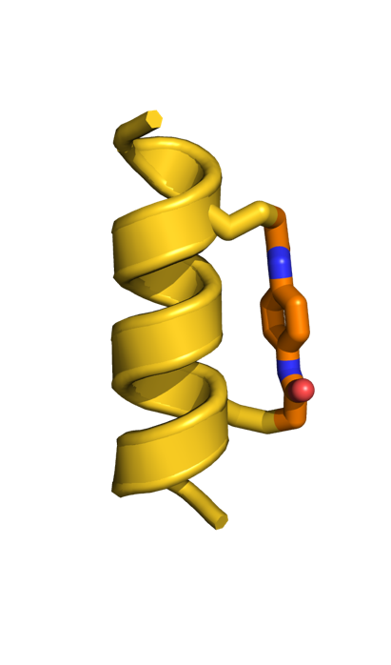
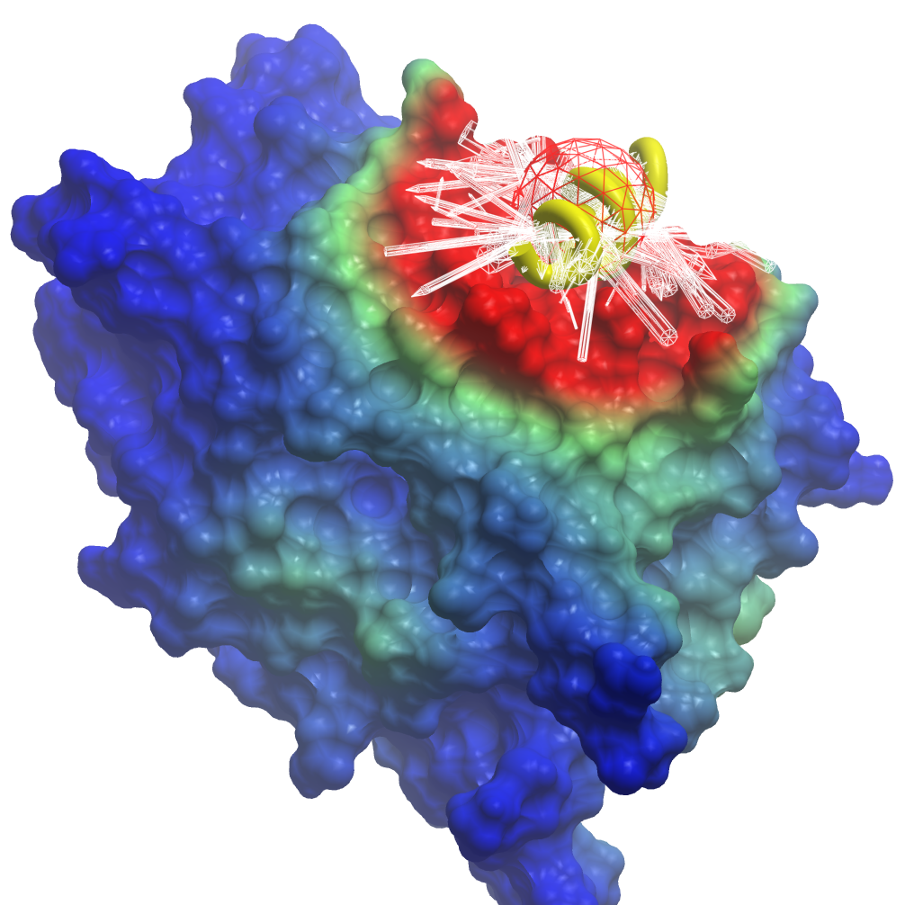
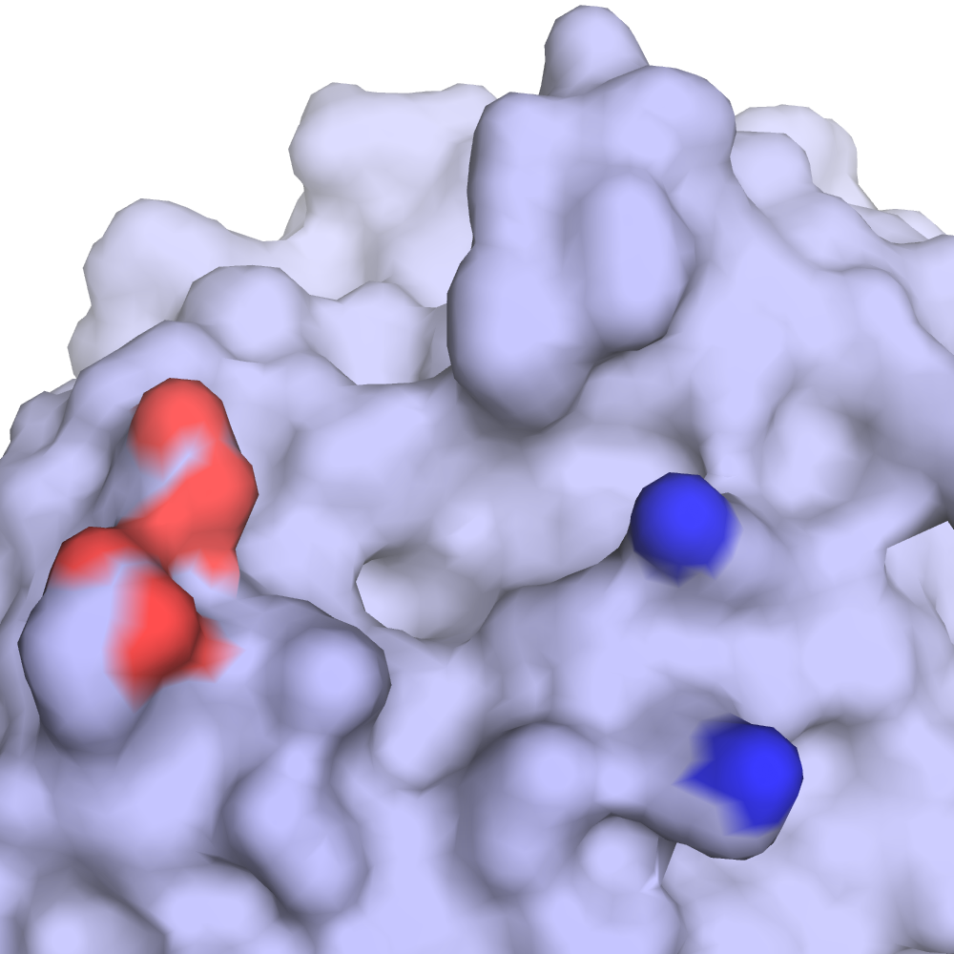
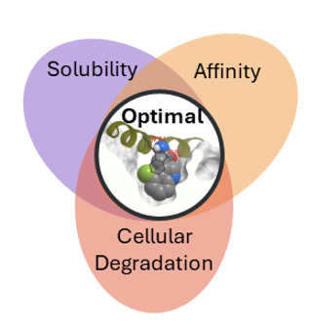
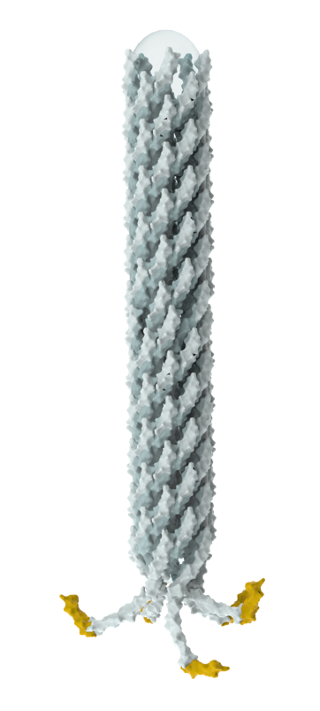
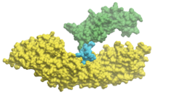

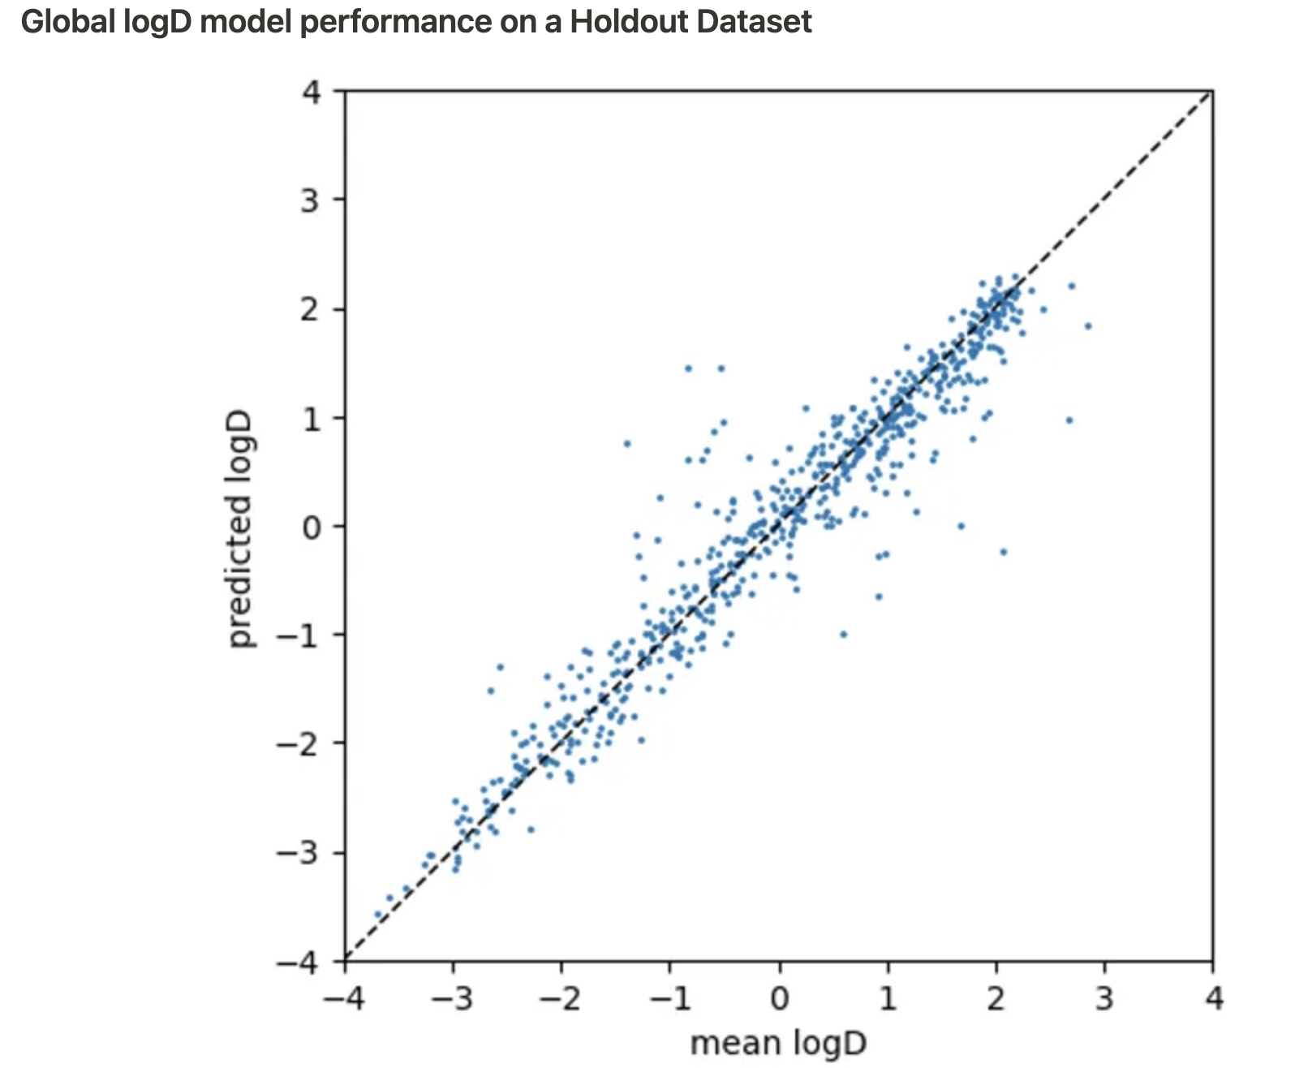

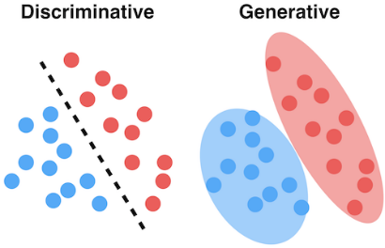

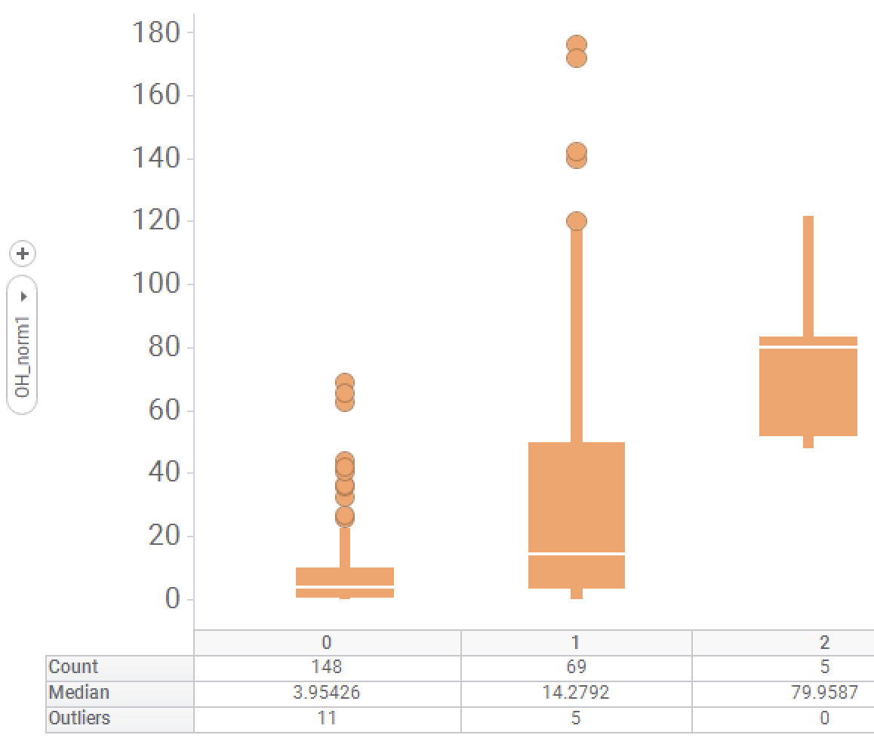
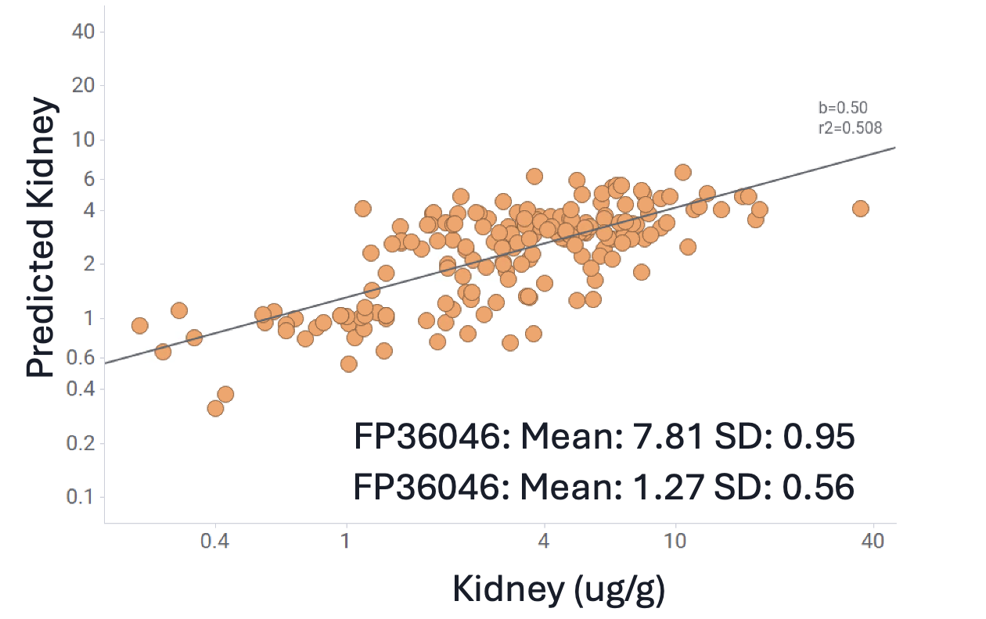
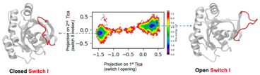
Seamless Integration of Custom Experiments and Computations Enables Rapid Helicon Discovery and Optimization
Target Evaluation
Hit Discovery
Hit-to-Lead
Lead Optimization
ML-Based Prediction of Helicon Binding Sites
Accurate for both positive and negative predictions
Highly-Parallelized Helical Phage & mRNA Display
In Silico De Novo Helicon Design
Multiplexed Mass Spec Library Screening
Generative Design
ML-driven multiparameter optimization
Library sizes: 10⁸ – 10¹²
Targets screened: ~140
Target hit rate: >60%
>10⁴⁵
11
>75%
Library sizes: 10,000s
Helicons tested: >300,000
Total data points: >10⁶
Degrader Simulations
Physics-based optimization
Predicted LogD
Actual CE
Low
Med
High
Actual LogD
Predicted CE
Foundational ML & Simulation Capabilities
ML-Based Property Predictions to Inform Design
Built with in-house data collected across dozens of chemical series
ADMET
ML and Helisite models
Notes:
Proprietary data; custom methods

Slide 5
Seamless Integration of Custom Experiments and Computations Enables Rapid Helicon Discovery and Optimization
Target Evaluation
Hit Discovery
Hit-to-Lead
Lead Optimization
ML-Based Prediction of Helicon Binding Sites
Accurate for both positive and negative predictions
Highly-Parallelized Helical Phage & mRNA Display
In Silico De Novo Helicon Design
Multiplexed Mass Spec Library Screening
Generative Design
ML-driven multiparameter optimization
Library sizes: 10⁸ – 10¹²
Targets screened: ~140
Target hit rate: >60%
>10⁴⁵
11
>75%
Library sizes: 10,000s
Helicons tested: >300,000
Total data points: >10⁶
Degrader Simulations
Physics-based optimization
Predicted LogD
Actual CE
Low
Med
High
Actual LogD
Predicted CE
Foundational ML & Simulation Capabilities
ML-Based Property Predictions to Inform Design
Built with in-house data collected across dozens of chemical series
ADMET
ML and Helisite models
Notes:
Proprietary data; custom methods

Slide 6
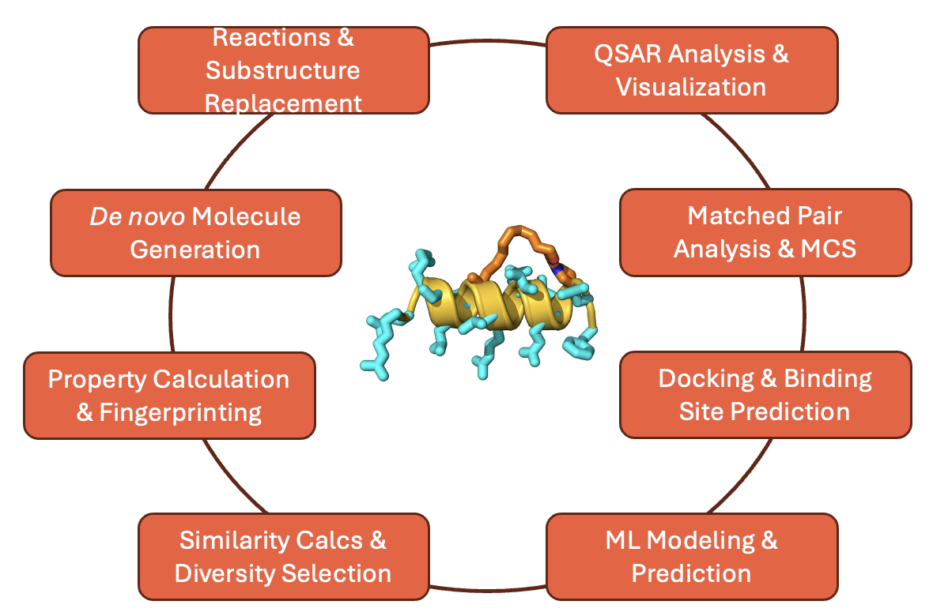
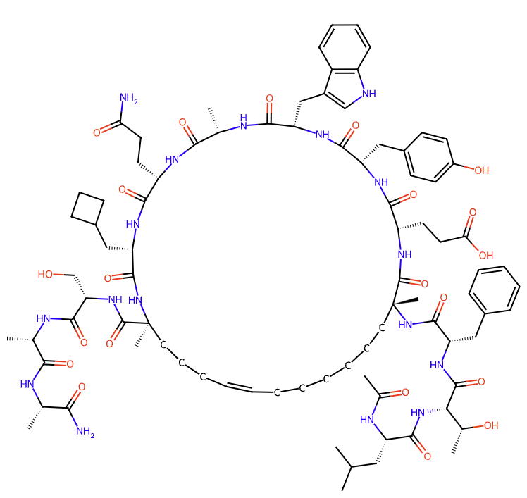
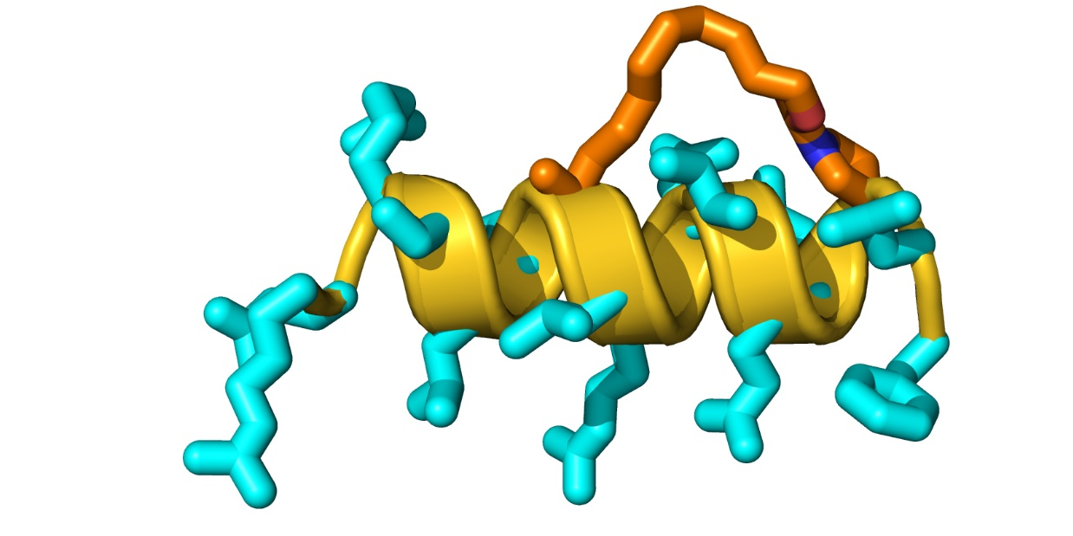
More efficient drug discovery for Helicon peptides requires a custom ecosystem of compatible tools & capabilities
Ac-Leu-Thr-Phe-$R8-Glu-Tyr-Trp-Ala-Gln-Cba-$S5-Ser-Ala-Ala-NH2
1D
Enumeration
2D
Conformer generation
3D
Notes:
FP00001413

Slide 7
More efficient drug discovery for Helicon peptides requires a custom ecosystem of compatible tools & capabilities
Ac-Leu-Thr-Phe-$R8-Glu-Tyr-Trp-Ala-Gln-Cba-$S5-Ser-Ala-Ala-NH2
1D
Enumeration
2D
Conformer generation
3D
Notes:
FP00001413

Slide 8

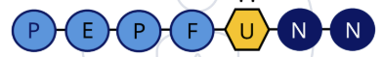

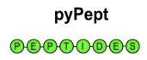




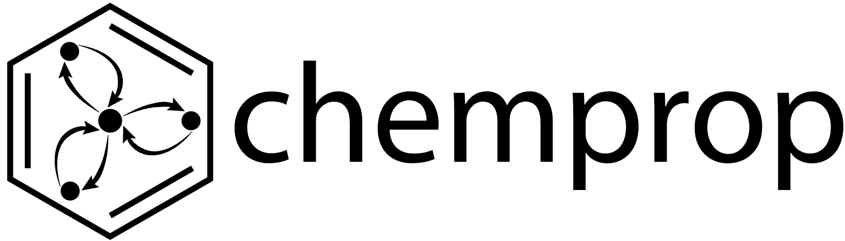
More efficient drug discovery for Helicon peptides requires a custom ecosystem of compatible tools & capabilities
Ac-Leu-Thr-Phe-$R8-Glu-Tyr-Trp-Ala-Gln-Cba-$S5-Ser-Ala-Ala-NH2
1D
Enumeration
2D
Conformer generation
3D

Slide 9
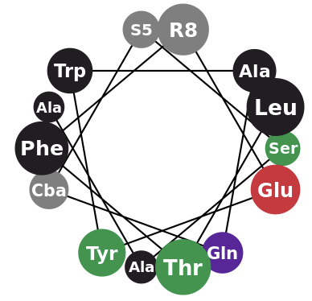
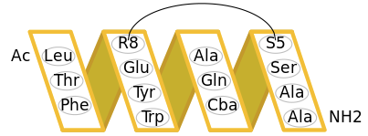


Helicon Peptides can be described in many ways
1
2
3
4
5
1
Ac-Leu-Thr-Phe-$R8-Glu-Tyr-Trp-Ala-Gln-
Cba-$S5-Ser-Ala-Ala-NH2
Format | Parabilis Sequence | BILN | HELM | SMILES | InchiKey
Human Readable?
Requires DB to Decode
Unique for Molecule
Explicit R-group not required
2
Ac-Leu-Thr-Phe-R8(1,3)-Glu-Tyr-Trp-Ala-Gln-Cba-S5(2,3)-Ser-Ala-Ala-NH2.RCMtrans(1,1)(2,2)
PEPTIDE1{L.T.F.[R8].E.Y.W.A.Q.[Cba].[S5].S.A.A}|CHEM1{[Ac]}|CHEM2{[NH2]}|CHEM3{[RCMtrans]}$CHEM1,PEPTIDE1,1:R1-1:R1|CHEM2,PEPTIDE1,1:R1-14:R2|CHEM3,PEPTIDE1,1:R1-4:R3|CHEM3,PEPTIDE1,1:R2-11:R3$$$V2.0
3
CC(=O)N[C@@H](CC(C)C)C(=O)N[C@H](C(=O)N[C@@H](Cc1ccccc1)C(=O)N[C@]1(C)CCCCCC/C=C/CCC[C@@](C)(C(=O)N[C@@H](CO)C(=O)N[C@@H](C)C(=O)N[C@@H](C)C(N)=O)NC(=O)[C@H](CC2CCC2)NC(=O)[C@H](CCC(N)=O)NC(=O)[C@H](C)NC(=O)[C@H](Cc2c[nH]c3ccccc23)NC(=O)[C@H](Cc2ccc(O)cc2)NC(=O)[C@H](CCC(=O)O)NC1=O)[C@@H](C)
4
Most intuitive for chemists’ design process
5
OUEOCESQEOWHKDQ-HMWZRHKHSA-N
enables enumeration & interconversion!
Notes:
Syntactic ; more readable but heavy lifting on the back end

Slide 10
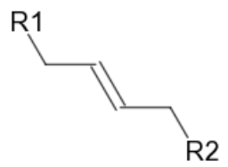
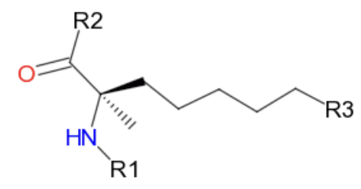
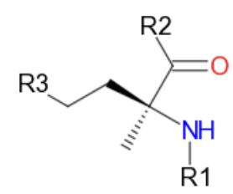
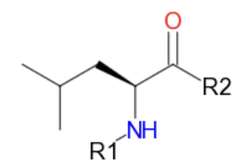
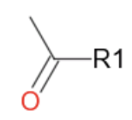
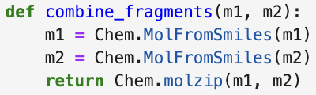
RDKit enables flexible, chemically-aware enumeration
Ring-Closing Metathesis
RCMTrans
Strategy 1 (DB-Centric):
Join CHEM to Monomer AAs
…
R8
S5
Leu
Ac
[*:1] joins to [*:1], [*:2] joins to [*:2], …

Slide 11
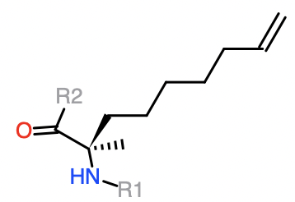
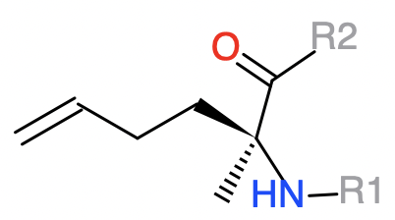
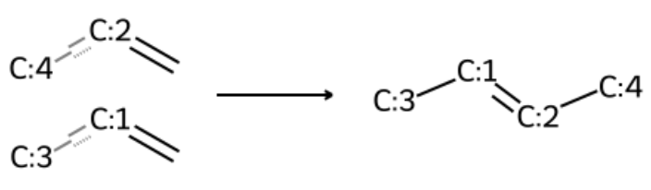
RDKit enables flexible, chemically-aware enumeration
Ring-Closing Metathesis
RCMTrans
Strategy 1 (DB-Centric):
Join CHEM to Monomer AAs
…
R8
S5
Leu
Ac
Strategy 2 (Chemically Aware):
React terminal alkenes
[*:1] joins to [*:1], [*:2] joins to [*:2], …
Notes:
We can do all kinds of chemistry, we want an enumerator

Slide 12
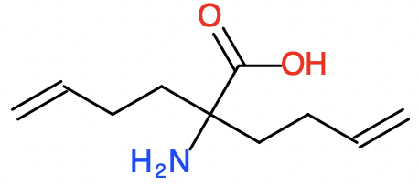
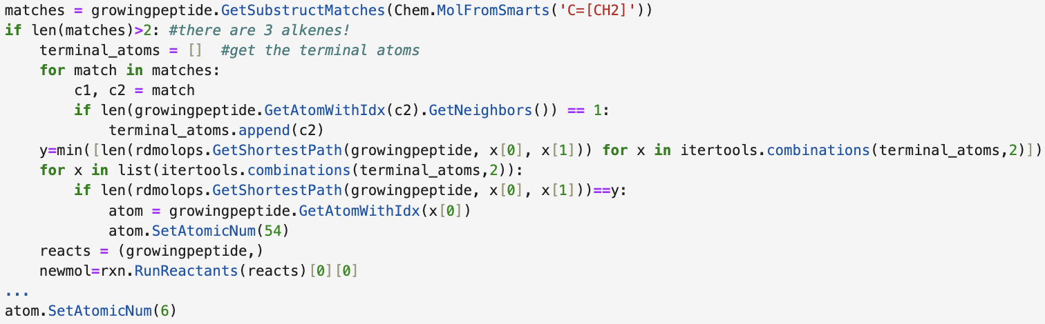
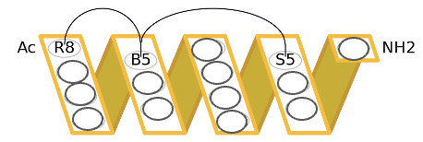
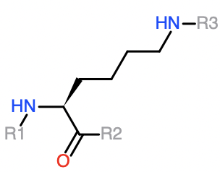
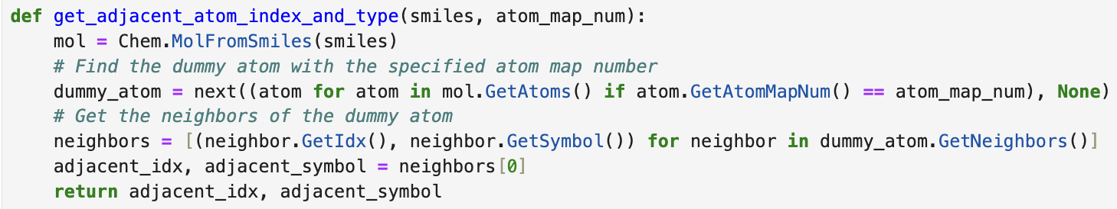
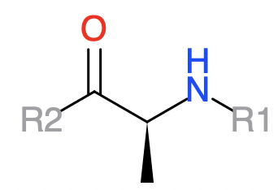
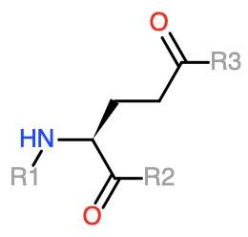
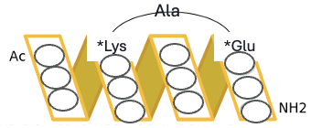
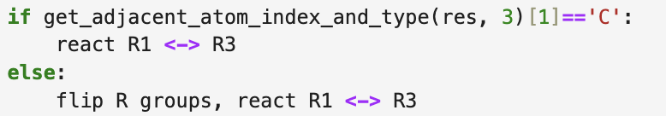
More chemically aware & creative enumerations
R8
S5
B5
Lys
Ala
Glu
Notes:
Simplify code

Slide 13
More chemically aware & creative enumerations
R8
S5
B5
Lys
Ala
Glu
Notes:
Simplify code

Slide 14
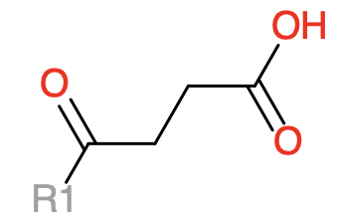
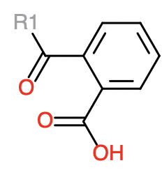
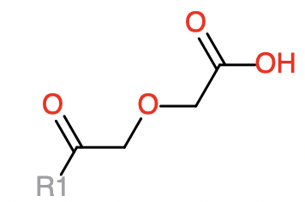
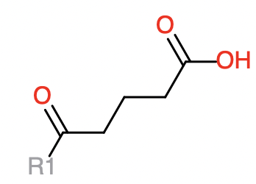


Extending custom enumerations with MatchedPairs Analysis
Real Example: Can we tag d-Lysine with a catalog of acid-containing substituents to improve solubility?
+
dLys
Succinate
Phthalate
Diglycolate
Glutarate
vs
dAla
c3COOHCy

Slide 15

Extending custom enumerations with MatchedPairs Analysis
Real Example: Can we tag d-Lysine with a catalog of acid-containing substituents to improve solubility?
+
dLys
Succinate
Phthalate
Diglycolate
Glutarate
vs
dAla
c3COOHCy

Slide 16




Matched Pairs help identify solubility-improving capping groups
Real Example: 3 of the tested lysine-acid caps improved kinetic solubility across 3 different parent scaffolds
Parent 1
Parent 2
Parent 3
Kinetic Solubility
Difference (in uM)
+
dLys
Capping Groups
135COOHPh
Ac
Terephthalate

Slide 17


Peptide Featurizations Help Us Better Understand & Predict Structure-Activity Relationships
One Hot Encodings
…-dSer-dTrp-dCys-…
0 | 0 | 1 | 0 | 0 | 1 | 0 | 0 | 0 | 1 | 0 | 0 | 0
Property Encodings

Slide 18


Peptide Featurizations Help Us Better Understand & Predict Structure-Activity Relationships
One Hot Encodings
Topological Fingerprints
…-dSer-dTrp-dCys-…
0 | 0 | 1 | 0 | 0 | 1 | 0 | 0 | 0 | 1 | 0 | 0 | 0
Property Encodings

Slide 19


Peptide Featurizations Help Us Better Understand & Predict Structure-Activity Relationships
One Hot Encodings
Topological Fingerprints
…-dSer-dTrp-dCys-…
0 | 0 | 1 | 0 | 0 | 1 | 0 | 0 | 0 | 1 | 0 | 0 | 0
Property Encodings

Slide 20

Peptide Featurizations Help Us Better Understand & Predict Structure-Activity Relationships
One Hot Encodings
Topological Fingerprints
Learned Representations
…-dSer-dTrp-dCys-…
0 | 0 | 1 | 0 | 0 | 1 | 0 | 0 | 0 | 1 | 0 | 0 | 0
Property Encodings

Slide 21

Peptide Featurizations Help Us Better Understand & Predict Structure-Activity Relationships
One Hot Encodings
Topological Fingerprints
Learned Representations
…-dSer-dTrp-dCys-…
0 | 0 | 1 | 0 | 0 | 1 | 0 | 0 | 0 | 1 | 0 | 0 | 0
Property Encodings
3D Descriptors

Slide 22

Peptides Occupy Different Regimes of Similarity/Property Space
Approved Drugs
ChEMBL33 Bioactives
# Compounds
13-mer Helicons
17-mer Helicons
Random 100 Pairwise
ECFP4 Tanimoto Similarity
Notes:
Macrocycles vs Peptides;
From a cheminformatics /descriptor point of view, we need to be more thoughtful;

Slide 23

Peptides Occupy Different Regimes of Similarity/Property Space
Approved Drugs
Approved Drugs
ChEMBL33 Bioactives
ChEMBL33 Bioactives
13-mer Helicons
13-mer Helicons
17-mer Helicons
17-mer Helicons
Random 100 Pairwise
ECFP4 Tanimoto Similarity
Molecular Weight
PARABILIS - MAKING THE NEXT GENERATION OF MEDICINES

Slide 24

Featurization → Regression → SAR to Rapidly Improve Affinity
With Santosh Choudary

Slide 25



We’ve Developed and Validated Supervised and Generative Machine Learning Capabilities That are Transforming How We Design and Test Helicons
We have developed ML models that can predict which Helicons are likely to enter the cell and engage with their target via a custom ML pipeline
These models enable a generative AI approach to suggest completely new Helicons with desired properties
Predicted cell penetration (low medium, high)
Existing Helicon space
True Positive Rate
UMAP2
False Positive Rate
Novel generated Helicons
UMAP1
Notes:
Focusing a bit more on the ML side. We have developed a substantial level of know how on how to 1) encode Helicons computationally, 2) what ML methods work better than others, and 3) implemented high-quality data processing pipelines that collectively make substantial impact on how we do drug discovery on a daily basis.
For example, our latest predictive cytosolic exposure (cell penetration) model – a critical and important property and advantage of our Helicons -- shows very good holdout (prospective) performance (High and Low perform well, with some room to improve in the medium category). The model was built on over 28,000 data points generated in-house
In addition, we have developed Generative AI methods that understand Helicons and leverage our ML models to produce novel synthetically feasible Helicons that can solve multiobjective problems – deeper example shown next
All of the ML/generative and computational approaches are designed to navigate vast chemical space as we can have over a 1000 non natural monomers comprising L and D space that we can combinatorically mix and match into Helicon space (the theoretical space is vast)

Slide 26


Generative AI identifies potent novel degraders with improved solubility from millions of possibilities
Tackling challenging multiobjective optimization problems
48/48 designs with solubility>10uM
ML Solubility
ML Affinity
Solubility (uM)
Optimal
ML Cellular Degradation
Parent
DC50 (nM)
Results in significant hit rate with many high solubility compounds and good to improved target degradation
Identified non-obvious monomers changes as new design rules
Generative AI identifies novel Helicons bounded by ML models for solubility, affinity and degradation (multiobjective optimization)
Notes:
To exemplify GenAI in action on a drug problem at Parabilis, here we are tackling a vexing but common drug discovery problem in which a chemical series on our ERG program suffered from a compensatory problem between cellular function (binding and degrading the target) and solubility. The method was able to find a small focused set or 48 compounds all of which have greatly improved solubility and, in many cases, also improved the cellular degradation potency. All these compounds were both synthetically feasible and non obvious (a challenge of many generative methods) and were efficiently extracted from millions of possibilities.
Note the method doesn't screen all possibilities but rather smartly navigates the vast chemical space

Slide 27
Conclusions
Key cheminformatics capabilities required for Helicon-peptide therapeutic discovery & development are enabled by many open source packages, especially RDKit
Helicon Peptides can be represented in numerous formats. Tools to flexibly enumerate and interconvert these formats are critical for downstream applications.
Matched Pair and SAR analyses enable identification of key structural contributors toward activities across large datasets
Calculated representations enable downstream ML on peptides, including generative design toward multi-objective optimization

Slide 28


Acknowledgements
Computational Drug Discovery
Neann Mathai
Faduma Khalif
Sameer Rawat
Kellon Belfon
Varun Shivashankar
Yelena Arnautova
Donovan Chin
Chemistry & Biology
Santosh Choudary
Archana Iyer
Sam Jordan
Sarah Judge
Kelly Freides
Brian White
Lee Belding
Paula Ortet
Julia Bowers
Senior Leadership
John McGee
Donovan Chin
Jonathan Hurov
Brandon Allgood
Mathai Mammen

Slide 29
Thank You

